Slide 1
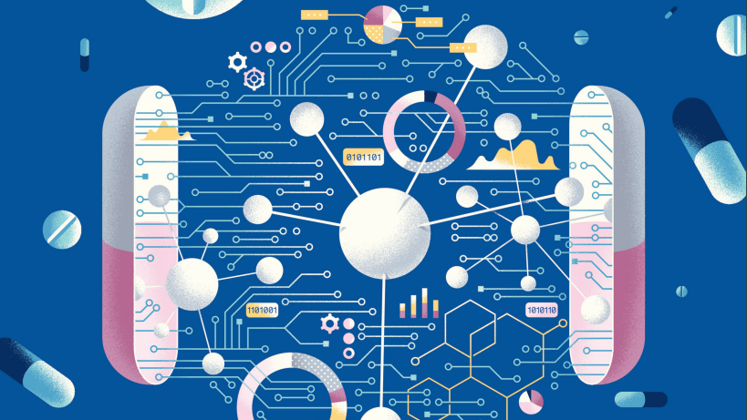
A generative-modelling tool for Hit expansion
Marc Molina

Slide 2
Index
Introduction
Generative modelling
Project Overview
Molecular Language Model as Multi-Task Generator
Compound properties prediction
Web-app demonstration
Conclusions and future directions

Slide 3
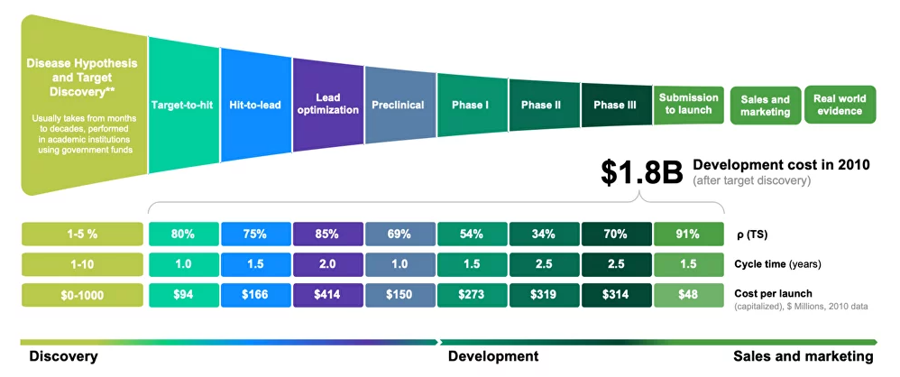
Drug discovery in healthcare
Fig.1 Drug discovery and development [1]

Slide 4
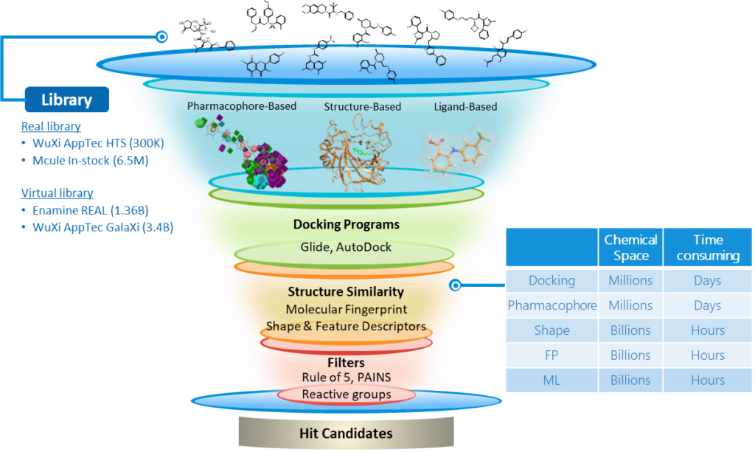
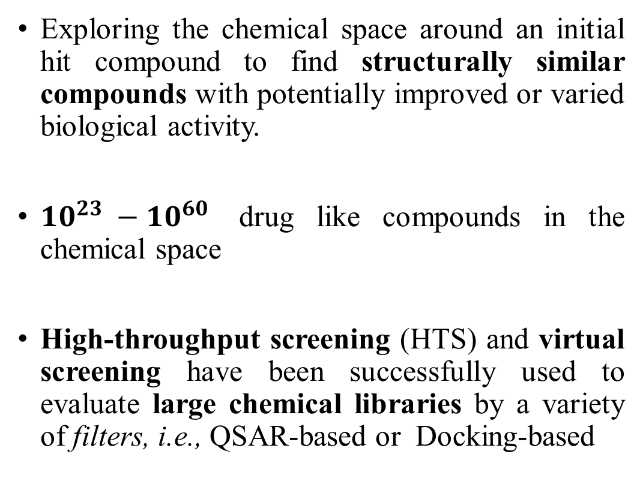
Hit-to-Lead: Hit expansion
Exploring the chemical space around an initial hit compound to find structurally similar compounds with potentially improved or varied biological activity.
${10}^{23} −{10}^{60}$ drug like compounds in the chemical space
High-throughput screening (HTS) and virtual screening have been successfully used to evaluate large chemical libraries by a variety of filters, i.e., QSAR-based or Docking-based
QSAR - Quantitative structure-activity relationship

Slide 5
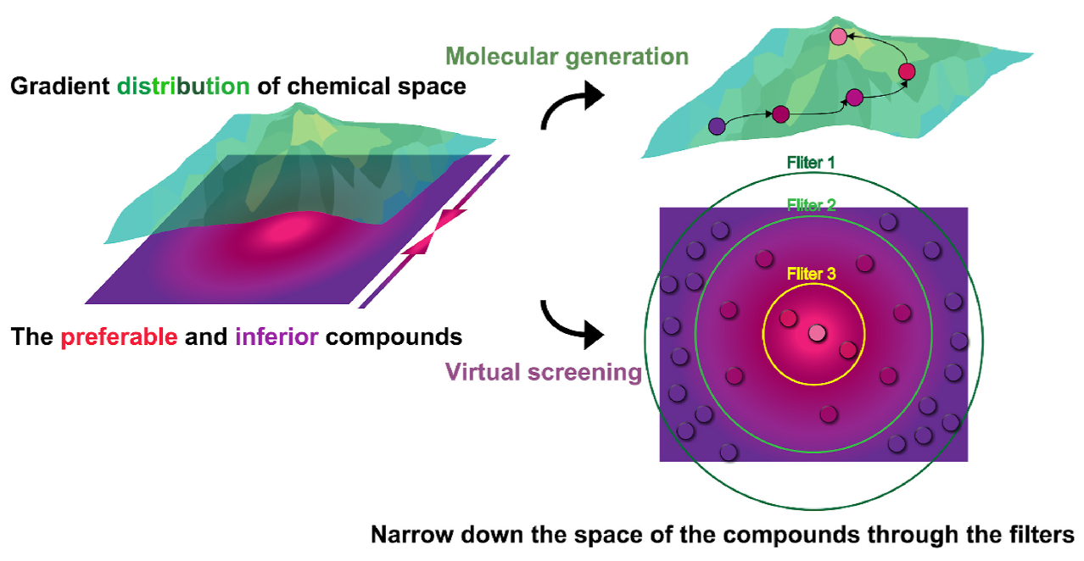
de novo drug design
Aims to learn and explore a continuous chemical space distribution to generate diverse and novel molecules with desirable properties
DL-based generative models can summarize and extract properties of existing molecules in a chemical space and then transforming them into novel scaffolds (Reverse QSAR process) [2].

Slide 6
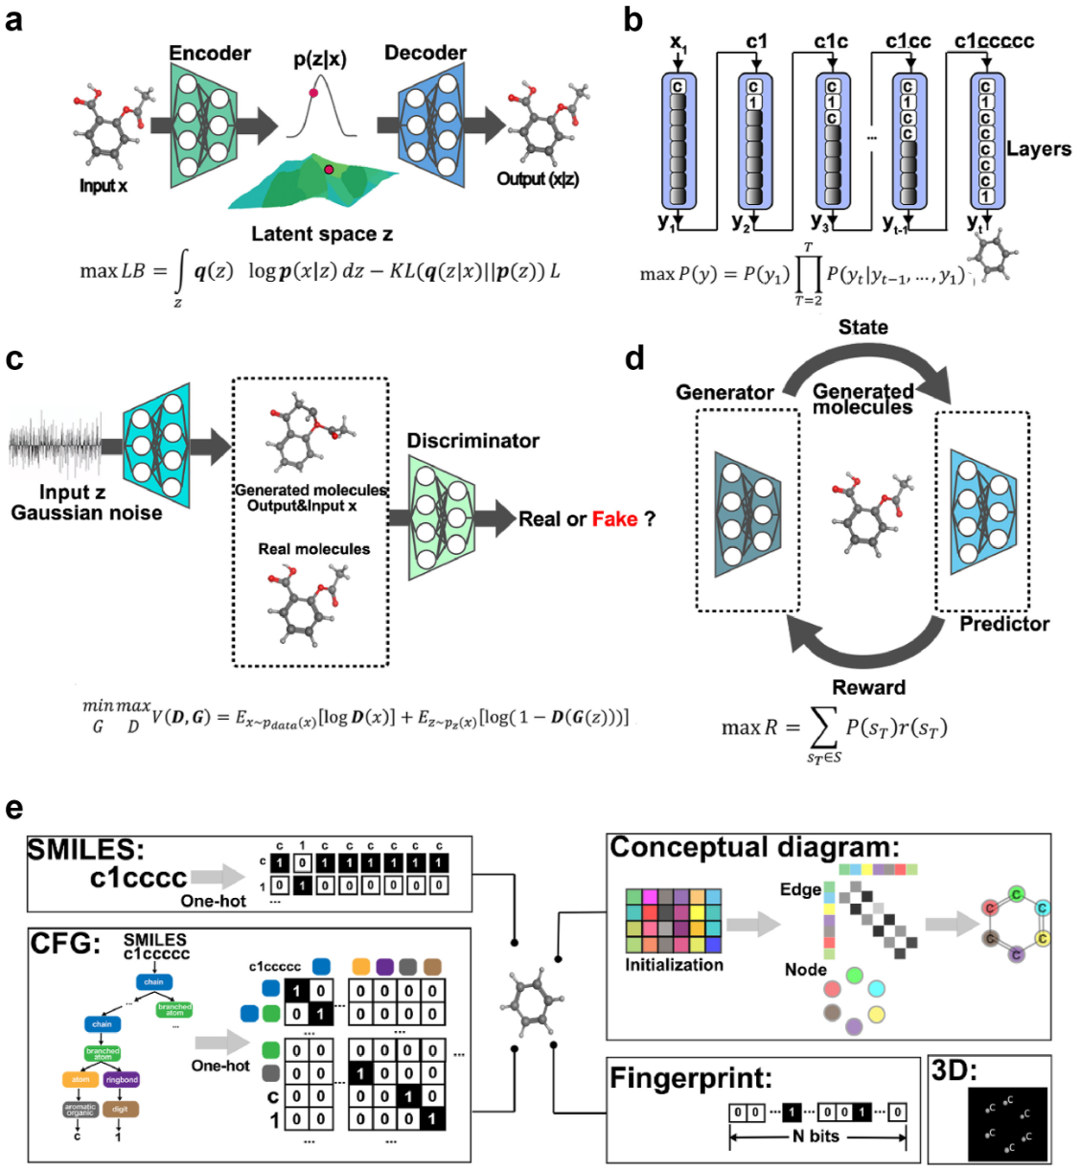
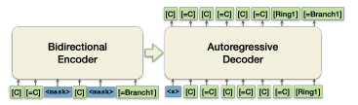
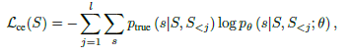
DL-based Generative modelling
VAE
RNN
Generative modelling families:
Recurrent neural networks (RNNs)
Variational Auto-encoder (VAEs)
Reinforcement Learning (RL)
Generative adversarial networks (GANs)
Pre-trained language models (PLMs)
GAN
RL
PLM

Slide 7
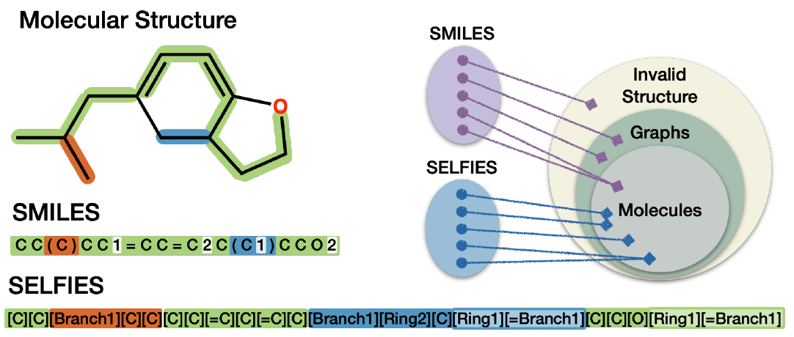
Molecular language
Recent advancements in language models have demonstrated their potential for understanding complex molecular distributions through the use of SMILES sequences.
SMILES brittleness can lead to:
Chemically invalid sequences by being syntactically incorrect or violate fundamental chemical principles
SELFIES [3] a string based representation where each combination of symbols maps to a chemically valid graph.

Slide 8

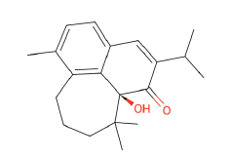
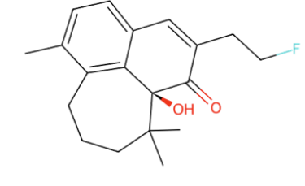
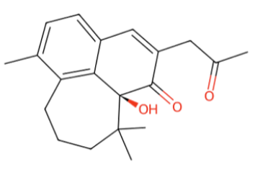
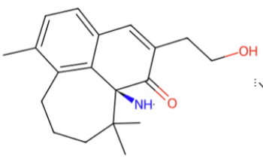



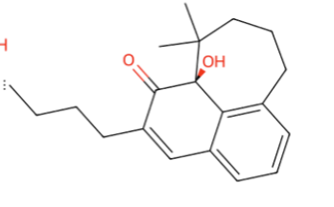

Project overview
SMILES
Number of compounds
Max & Min Length
Saving format (e.g .xlsx)
Molecular language model
Compound properties prediction
+ compound properties
SMILES to SELFIES
SELFIES to SMILES
Flask Web-App

Slide 9
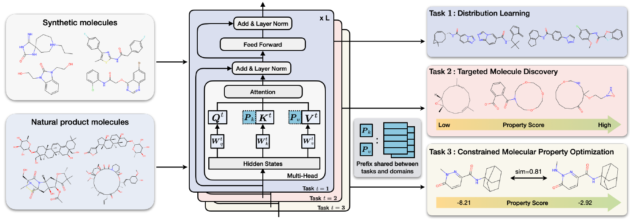
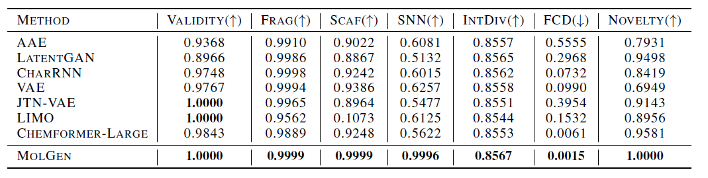
Molecular Language Model as Multi-task Generator
A pre-trained molecular language model that effectively learns and shares knowledge across multiple generation tasks and domains [4].
Multi-task training routine
Internal validation [4]

Slide 10
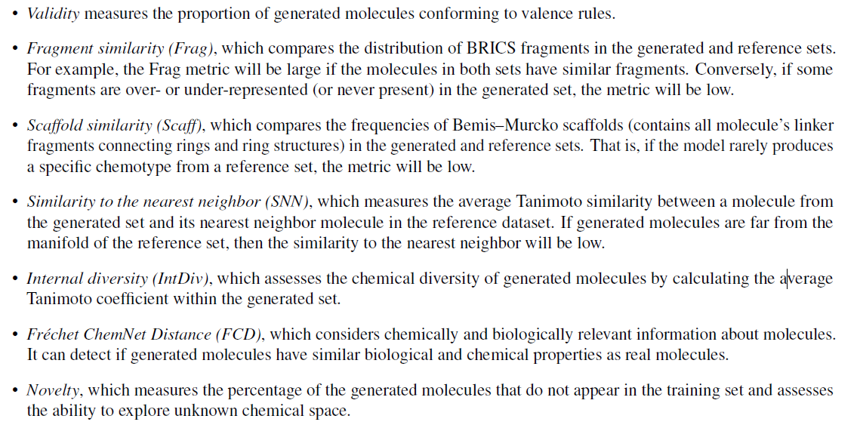
External validation metrics
Performance validation in benchmark dataset: MOSES [5]
https://github.com/molecularsets/moses

Slide 11
External validation metrics
5925 test small molecules with 10 return sequences ; TOTAL N : 59250
Validity : 1.0
unique@100 : 0.92
unique@1000: 0.90
FCD : 3.57
SNN : 0.63
Frag : 0.98
Scaf: 0.94
IntDiv : 0.87
Novelty : 0.97
Great target drug generative modelling capabilities
Small decrease of performance metrics shown in [4]

Slide 12

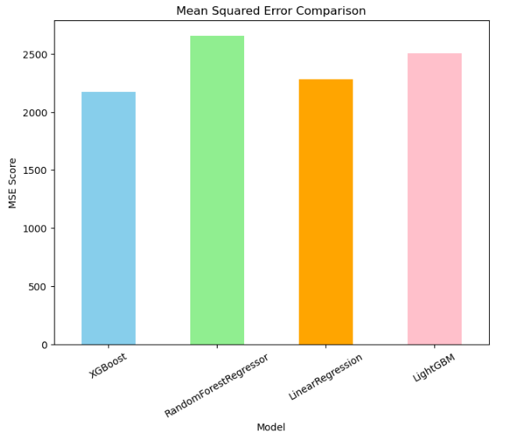
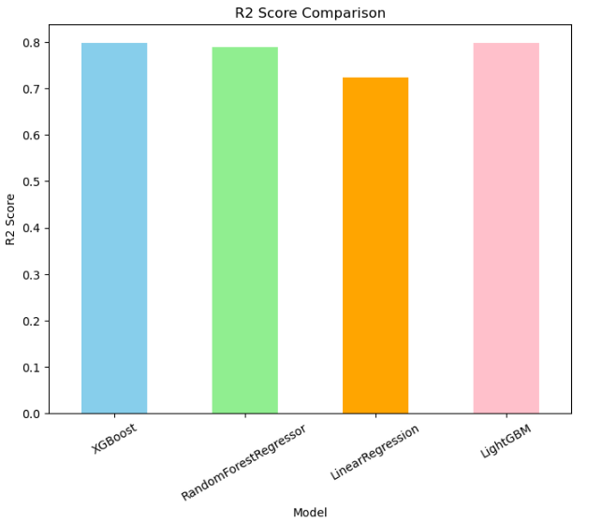
Compound Properties Predictor
>50K Compounds
SMILES
Molecular Formula
Molecular weight
XLogP
Exact mass
TPSA
Complexity
Charge
XLogP: measure of hydrophilcity or hydrophobicity of a molecule.
TPSA: This is an estimate of the area (in Å2) which is polar.
Complexity: estimate of how complicated the structure is, seen from the point of view of both the elements contained and the displayed structural features including symmetry. Computed using the Bertz/Hendrickson/Ihlenfeldt formula

Slide 13
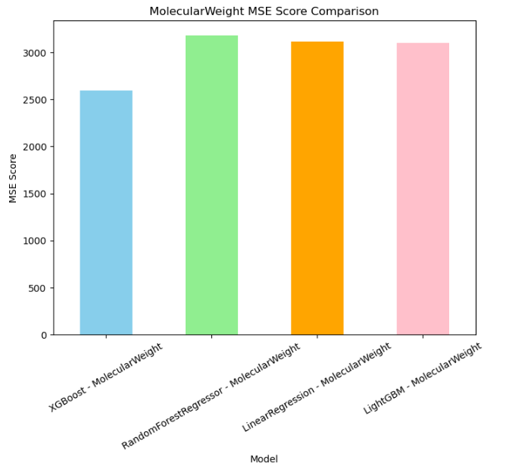
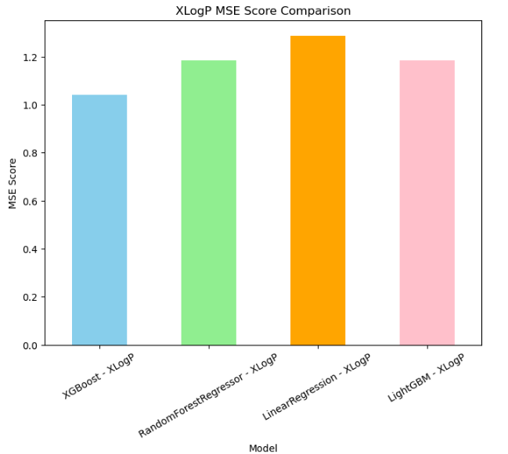
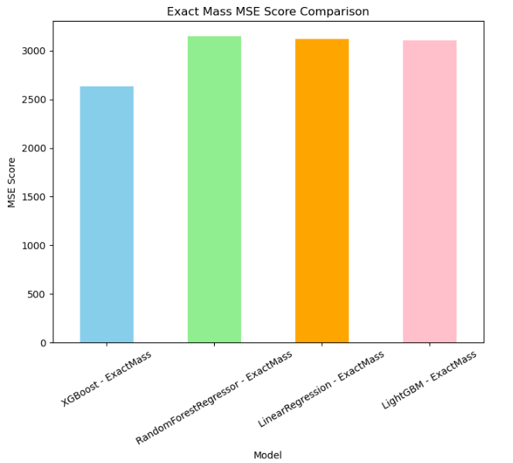
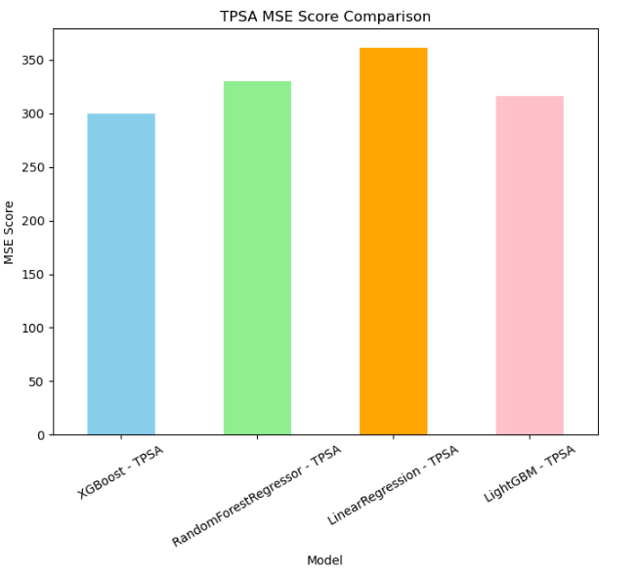
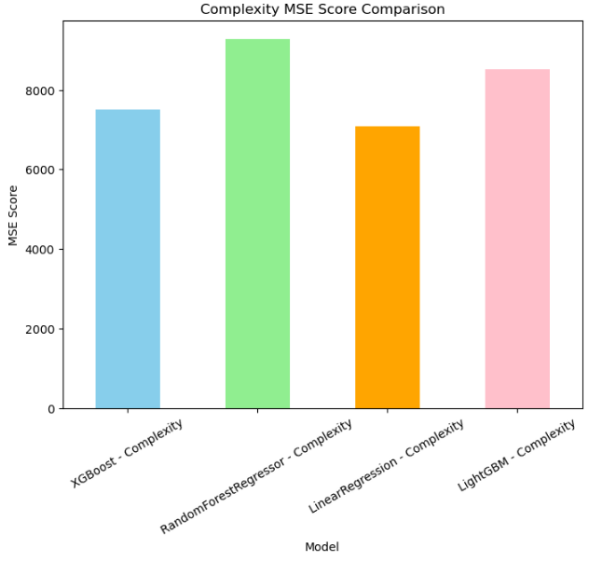
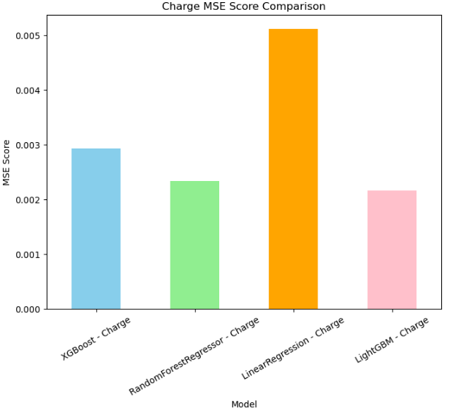
Compound Properties Predictor

Slide 14
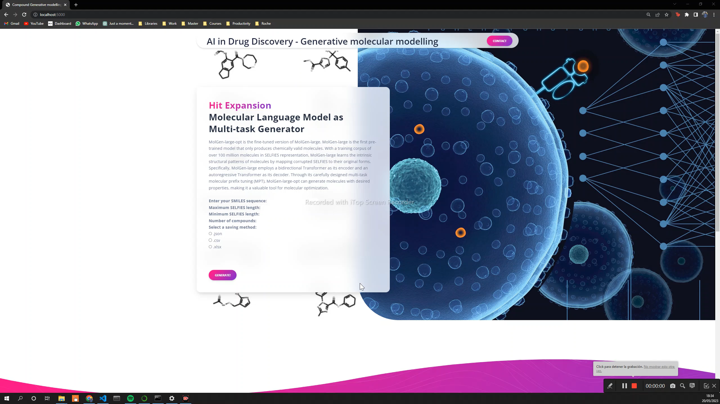
Web-app demonstration

Slide 15
Conclusions and Future directions
A framework for hit expansion has been successfully developed through the use of pre-trained molecular language model
Properties prediction have been properly predicted from SMILES sequences using a XGBoost model.
Addition of more Virtual Screening tools to increase the filtering and to provide a more comprehensive expansion
Models to predict toxicity, QSAR, Docking, etc.
Fine-tune molecular language model for our downstream task

Slide 16
References
[1] A breakthrough milestone in AI-powered drug discovery reached linking biology and chemistry with AI. (n.d.). Insilico.com. https://insilico.com/blog/pcc
[2] Wang, M., Wang, Z., Sun, H., Wang, J., Shen, C., Weng, G., Chai, X., Li, H., Cao, D., & Hou, T. (2022). Deep learning approaches for de novo drug design: An overview. Current Opinion in Structural Biology, 72, 135–144. https://doi.org/10.1016/j.sbi.2021.10.001
[3] Krenn, M., Häse, F., Nigam, A., Friederich, P., & Aspuru-Guzik, A. (2020). Self-Referencing Embedded Strings (SELFIES): A 100% robust molecular string representation. Machine Learning: Science and Technology, 1(4), 045024. https://doi.org/10.1088/2632-2153/aba947
[4] Fang, Y., Zhang, N., Chen, Z., Fan, X., & Chen, H. (2023, May 18). Domain-Agnostic Molecular Generation with Self-feedback. ArXiv.org. https://doi.org/10.48550/arXiv.2301.11259
[5] Polykovskiy, D., Zhebrak, A., Sanchez-Lengeling, B., Golovanov, S., Tatanov, O., Belyaev, S., Kurbanov, R., Artamonov, A., Aladinskiy, V., Veselov, M., Kadurin, A., Johansson, S., Chen, H., Nikolenko, S., Aspuru-Guzik, A., & Zhavoronkov, A. (2020). Molecular Sets (MOSES): A Benchmarking Platform for Molecular Generation Models. Frontiers in Pharmacology, 11. https://doi.org/10.3389/fphar.2020.565644

